Slide 1
أكـــــاديميــــة طــــويـــق
Artificial Intelligence Ethics

Slide 2
Privacy and Security in Data Science
By: Dr. Afshan Hashmi

Slide 3
Course Objectives:
1. Understand the Importance of Data Privacy and Security.
2. Analyze the Role of AI in Enhancing Privacy and Security
3. Understand Legal and Regulatory Compliance

Slide 4

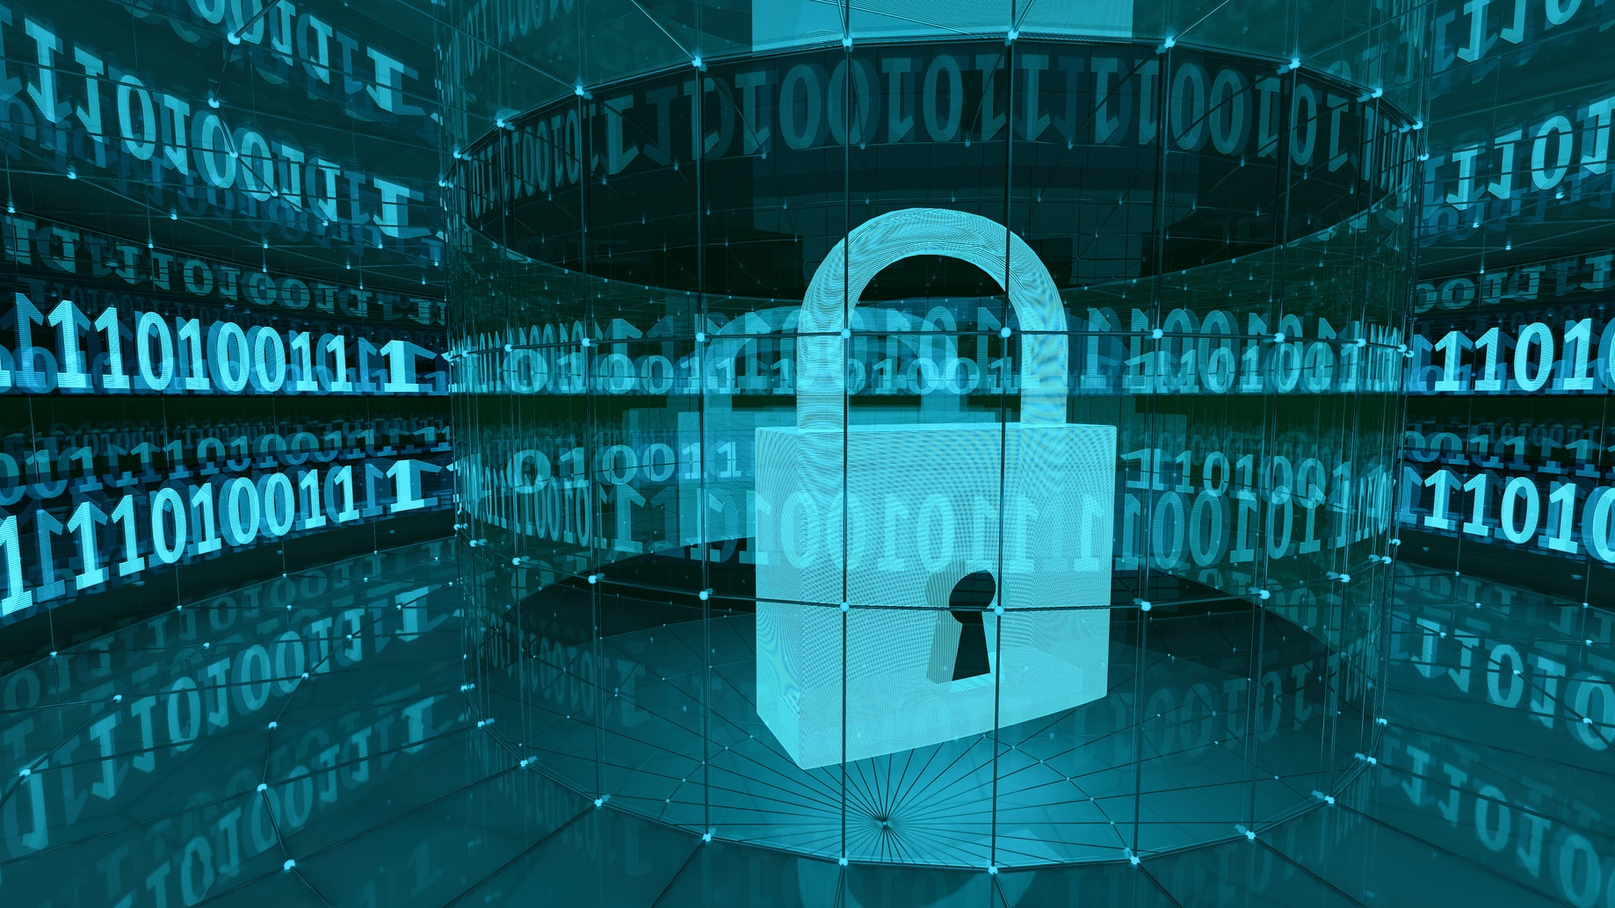
Privacy and Security in Data Science:
In today's data-driven world, privacy and security are critical concerns in data science, as organizations collect, store, and analyze vast amounts of personal and sensitive data. Ensuring the protection of this data is essential for compliance, trust, and ethical AI development.
Data Privacy refers to controlling access to personal information and ensuring individuals have rights over their data.
Data Security involves protecting data from unauthorized access, breaches, and cyber threats.
Why is this important?
Prevents data breaches that can lead to financial losses and reputational damage.
Ensures legal compliance with global regulations.
Builds trust with users, customers, and stakeholders.

Slide 5
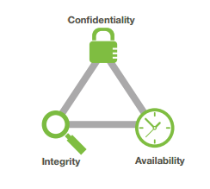
Key Principles of Data Protection: The CIA Triad
The CIA Triad (Confidentiality, Integrity, and Availability) is the foundation of data security.
Confidentiality – Ensuring that sensitive data is only accessible to authorized users.
Example:
Confidentiality: Encrypting user passwords in a database.
Integrity – Maintaining accuracy and consistency of data, preventing unauthorized modifications.
Example:
Integrity: Using checksums to verify data accuracy during transmission.
Availability – Ensuring data is accessible when needed, without disruption.
Example:
Availability: Implementing backup solutions to prevent data loss in case of cyberattacks.

Slide 6
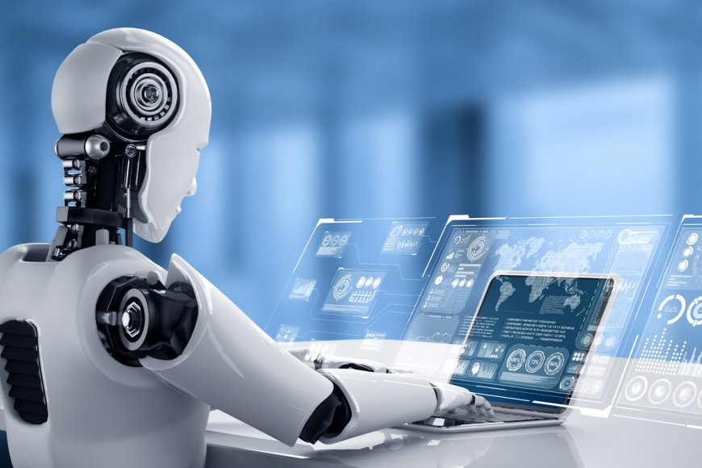
The Role of AI and Data Science in Securing Personal Data
Data science and AI play a crucial role in protecting privacy through:
Anomaly detection – AI models identify suspicious activities (e.g., fraud detection). Data anonymization – Masking or encrypting personal identifiers in datasets. Access control – Machine learning helps in dynamic user authentication. Automated compliance – AI-powered tools monitor regulatory compliance in real time.
Example: AI in cybersecurity detects phishing attacks by analyzing email content and sender behavior.

Slide 7
Privacy Regulations and Legal Frameworks Organizations must comply with various global privacy laws to avoid legal consequences. General Data Protection Regulation (GDPR) The GDPR is the European Union’s (EU) strictest privacy law, ensuring: User consent before data collection. Right to be forgotten – Users can request data deletion. Data breach notification within 72 hours. Example: If a company tracks website visitors, it must inform users and obtain explicit consent.

Slide 8
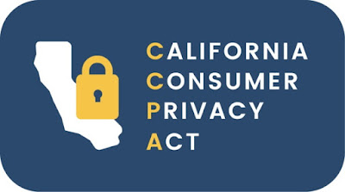
California Consumer Privacy Act (CCPA)
The CCPA is a U.S. law that grants California residents:
Right to know what data is collected.
Right to opt out of data sales.
Right to delete personal information.
Example: Social media platforms must allow users to opt out of targeted advertising.

Slide 9
Data Protection Act and Other International Privacy Laws
Several countries enforce strict data privacy laws, including:
India's Digital Personal Data Protection Act (DPDP)
Brazil's LGPD (Lei Geral de Proteção de Dados)
Canada’s PIPEDA (Personal Information Protection and Electronic Documents Act)

Slide 10
Legal Responsibilities of AI Developers and Organizations
AI developers and companies handling personal data must:
Ensure transparency in AI decision-making. Use privacy-enhancing technologies (PETs) like differential privacy.
Conduct regular security audits to detect vulnerabilities.
Example: A healthcare AI system must anonymize patient data before training a model.

Slide 11

Threats to Data Privacy and Security In today’s digital era, data privacy and security face numerous challenges due to evolving cyber threats, increasing data collection, and growing reliance on AI-driven technologies. Organizations must understand these threats to implement effective risk mitigation strategies.

Slide 12
Data Breaches, Unauthorized Access, and Malicious Attacks
What is a Data Breach?
A data breach occurs when sensitive information is exposed due to cyberattacks, accidental leaks, or internal security failures.
Common causes of data breaches:
Weak passwords – Easy-to-guess passwords can be exploited by hackers. Phishing attacks – Attackers trick users into revealing credentials. Unpatched software vulnerabilities – Hackers exploit outdated systems. Insider threats – Employees or third-party vendors leaking data.
Examples of data breaches:
Facebook (2019): 540 million records of users' data were exposed.
Equifax (2017): 147 million people’s financial data was stolen.

Slide 13
Unauthorized Access and Malicious Attacks
Cybercriminals use various techniques to gain unauthorized access to sensitive data:
Types of attacks: Ransomware – Hackers encrypt data and demand payment for its release. DDoS (Distributed Denial-of-Service) attacks – Overloading servers to crash a system. SQL injection – Attackers insert malicious SQL queries to access databases. Man-in-the-middle (MITM) attacks – Hackers intercept communication between two parties.
Example: A ransomware attack on a hospital can encrypt patient records, preventing doctors from accessing critical data.

Slide 14
Risks in Cloud Computing
Risks in Cloud Computing
Cloud services store vast amounts of personal and business data, making them prime targets for cyberattacks.
Key threats in cloud computing:
Data leakage – Unauthorized users access stored data. Misconfigured cloud settings – Poor security settings expose sensitive files. Insider threats – Employees or contractors may misuse cloud data.
Lack of encryption – Storing data without proper encryption increases risk.
Example: An improperly secured Amazon S3 bucket can expose millions of user records to public access.

Slide 15
Risks in IoT Systems
Risks in IoT (Internet of Things)
IoT devices (smartphones, home assistants, wearables) collect and transmit large amounts of data, making them vulnerable to cyber threats.
IoT security challenges: Weak authentication – Many IoT devices lack strong passwords. Unpatched vulnerabilities – Devices may not receive regular security updates. Data interception – Hackers can eavesdrop on device communications. Botnets – Hackers hijack IoT devices to launch cyberattacks (e.g., Mirai botnet).
Example: A hacked smart security camera can be used to spy on individuals or businesses.

Slide 16
Risks in AI Systems
As technology advances, cloud computing, Internet of Things (IoT), and AI introduce new privacy and security challenges.
Risks in Cloud Computing
Cloud services store vast amounts of personal and business data, making them prime targets for cyberattacks.
Key threats in cloud computing: Data leakage – Unauthorized users access stored data. Misconfigured cloud settings – Poor security settings expose sensitive files. Insider threats – Employees or contractors may misuse cloud data. Lack of encryption – Storing data without proper encryption increases risk.
Example: An improperly secured Amazon S3 bucket can expose millions of user records to public access.

Slide 17

Privacy Concerns in Sensitive Sectors (Healthcare, Finance, Government) Certain industries handle extremely sensitive data, making them high-risk targets for cyberattacks and privacy violations.
Healthcare
Electronic Health Records (EHRs) contain highly personal patient data.
HIPAA violations can result in fines for mishandling medical data.
Medical IoT devices (e.g., pacemakers, insulin pumps) are vulnerable to hacking.
Example: A ransomware attack on a hospital disrupts medical services, endangering patients.

Slide 18
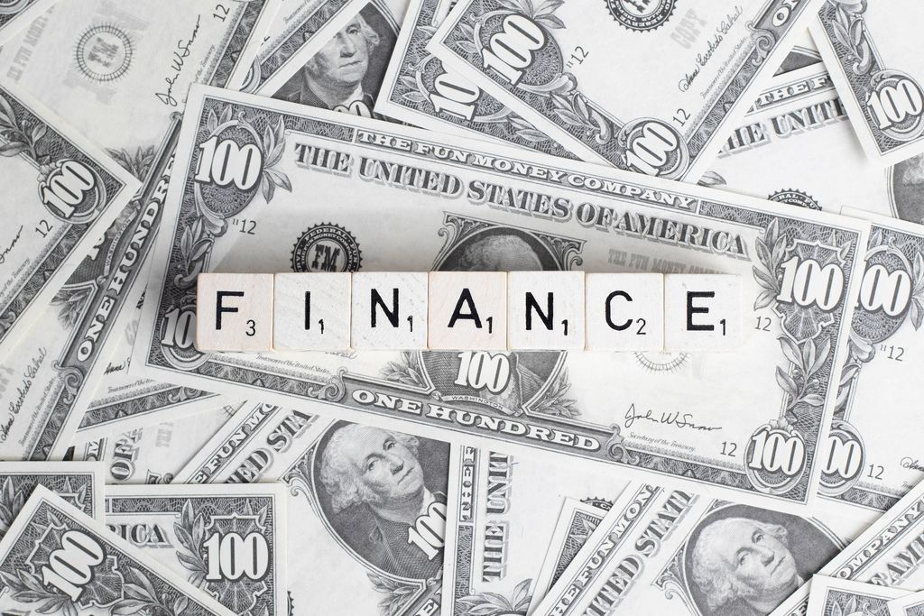
Privacy Concerns in Sensitive Sectors-Finance
Banks and financial institutions store credit card numbers, SSNs, and transaction data.
Online banking fraud and cryptocurrency hacks are increasing.
Identity theft allows cybercriminals to access financial accounts.
Example: The JP Morgan Chase data breach (2014) exposed 76 million bank accounts.
This Photo by Unknown Author is licensed under CC BY

Slide 19
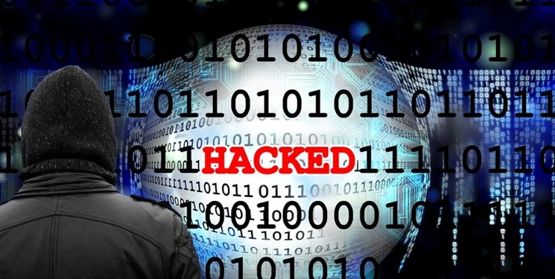
Privacy Concerns in Sensitive Sectors-Government
Governments store classified information on citizens, defense, and infrastructure.
Cyberattacks can disrupt national security and public services.
Surveillance concerns arise from excessive data collection.
Example: The 2020 SolarWinds cyberattack compromised multiple U.S. government agencies.

Slide 20
RECAP
Data privacy and security are essential for ethical AI development.
The CIA Triad (Confidentiality, Integrity, Availability) guides data protection strategies.
AI enhances privacy through encryption, authentication, and anomaly detection.
Organizations must comply with GDPR, CCPA, and other regulations to avoid legal risks.
Data breaches and unauthorized access are major threats to data security.
Cloud computing, IoT, and AI introduce new security vulnerabilities.
Healthcare, finance, and government sectors are prime targets for cyberattacks
Strong encryption, authentication, and AI-driven security can help mitigate risks.

Slide 21
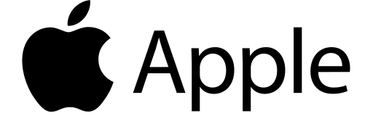
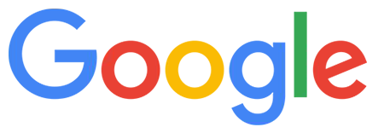
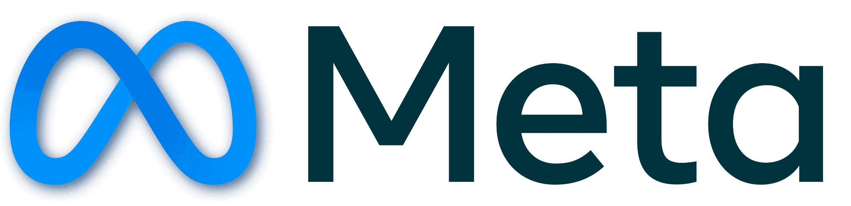
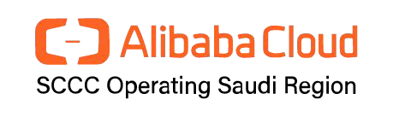
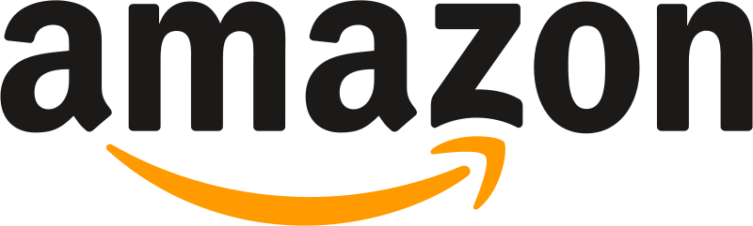
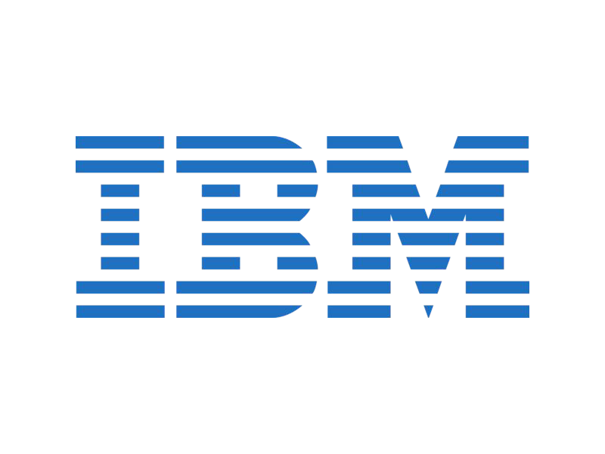
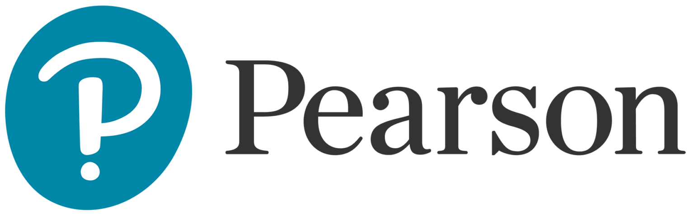
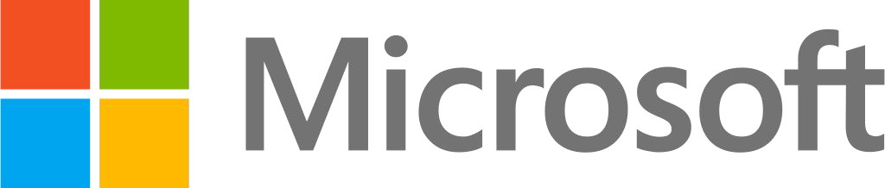
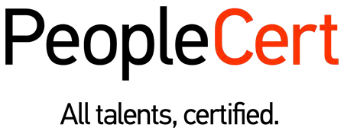
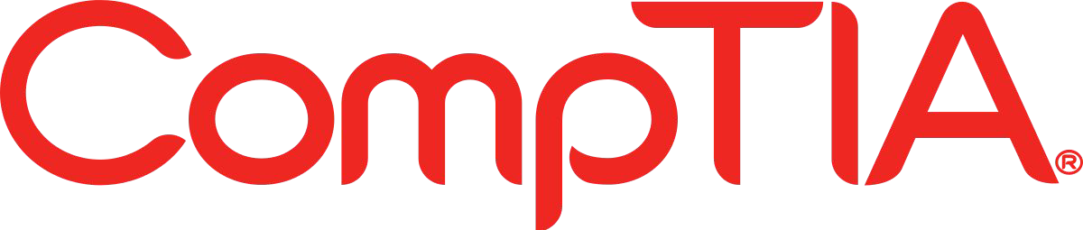

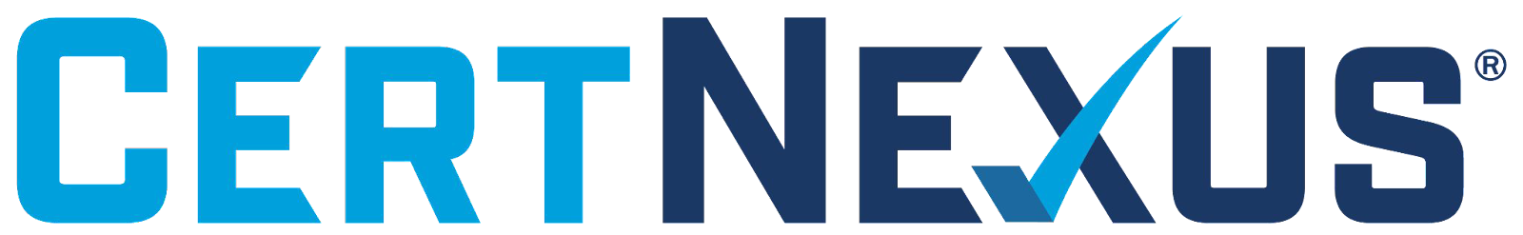
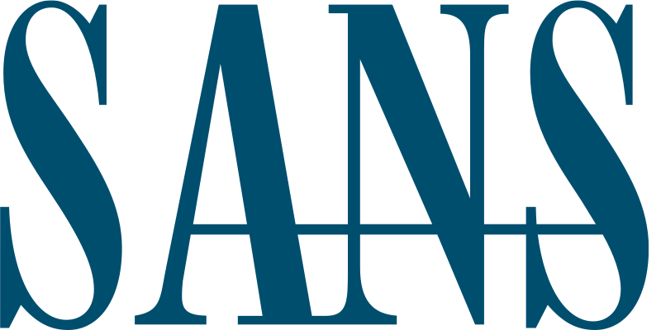

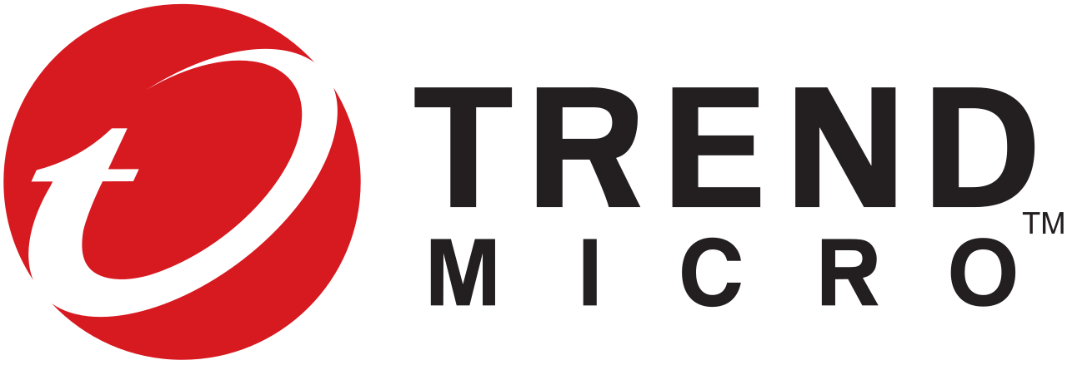


الشراكات العالمية

Slide 22
شــــــكــــرًا لكــــــم
THANK YOU

